Slide 1


Cardiometabolic conditions in people with autism spectrum disorder:
a nationwide population-based cohort study from the Netherlands
Yiran Li
PhD candidate
Interdisciplinary Center Psychopathology and Emotion regulation (ICPE)
Department of Psychiatry, University Medical Center Groningen (UMCG)
Submitted
Coauthors:
Tian Xie; Lin Li; Jing Lin; Melissa Vos; Zheng Chang; Harold Snieder; Catharina A. Hartman

Slide 2
The authors of this work declaring
no competing interests.

Slide 3
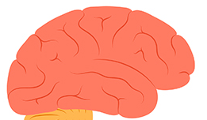
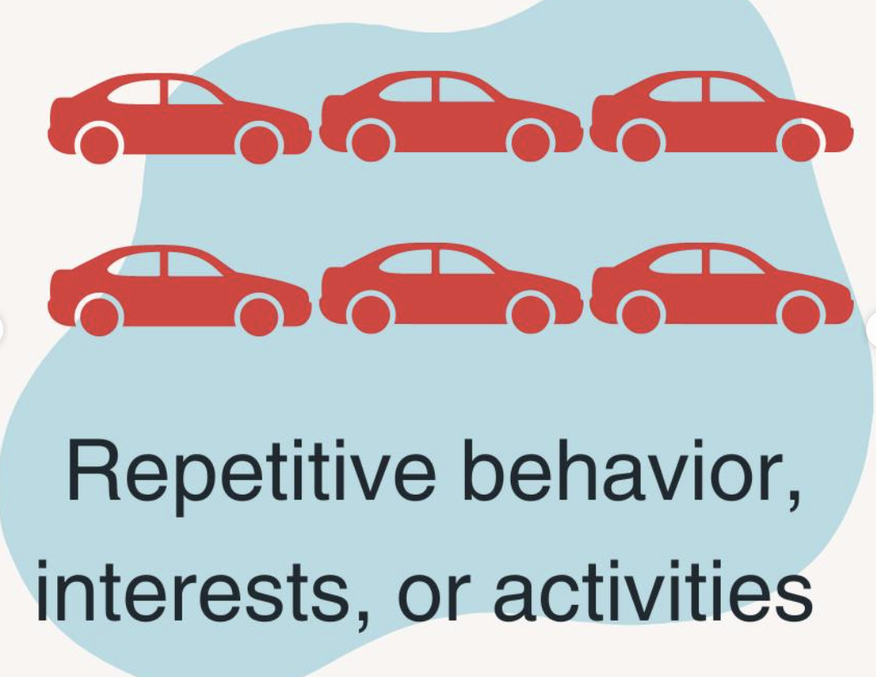
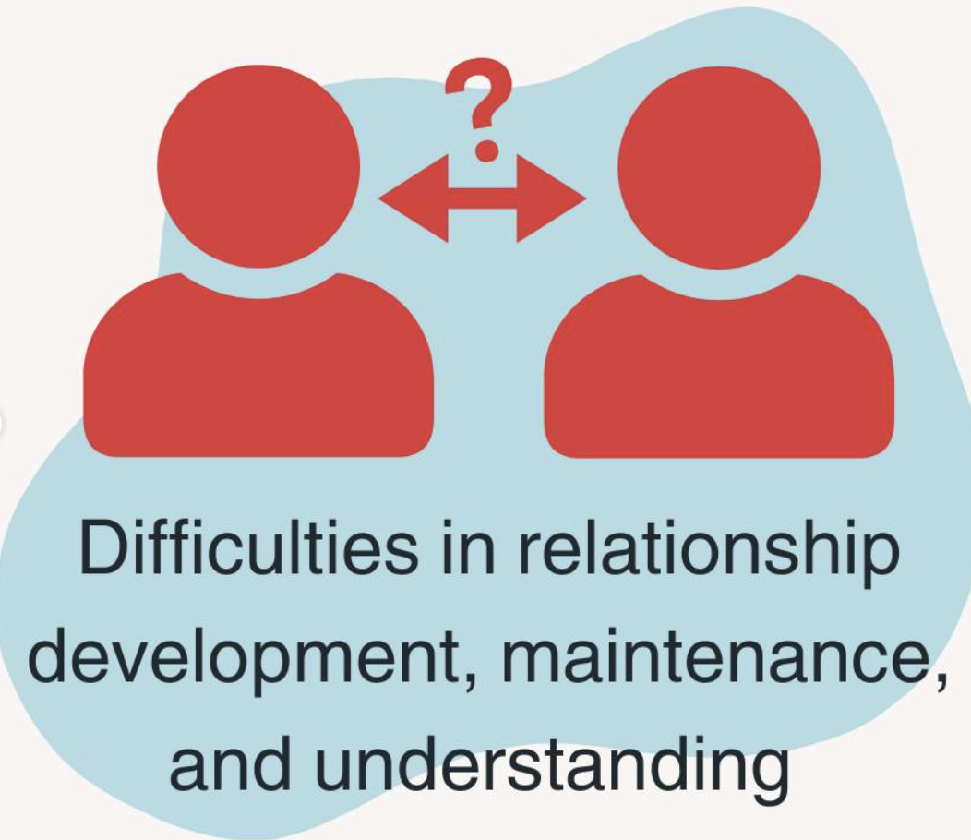
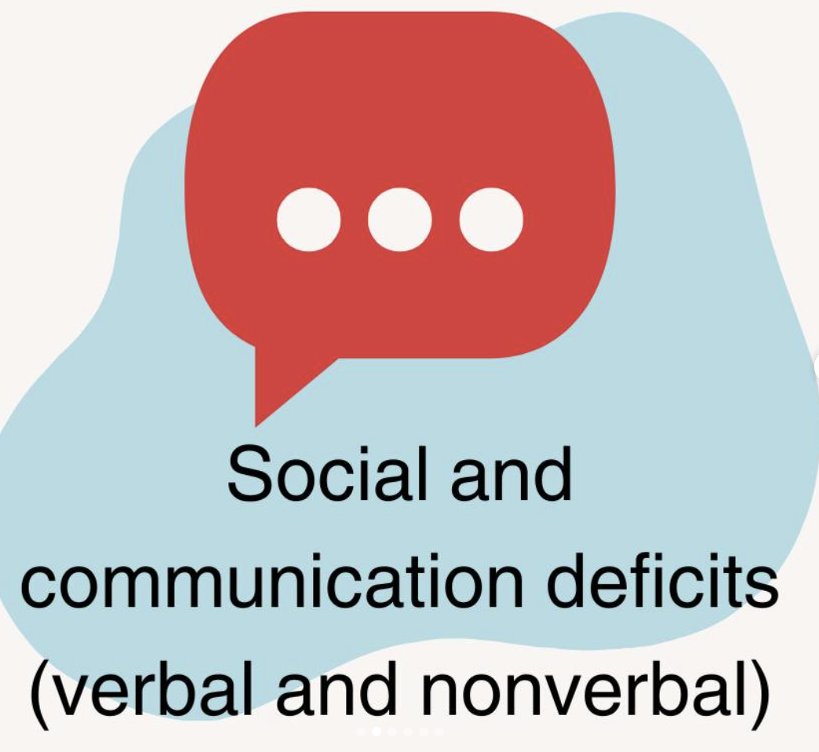

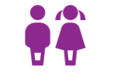




Autism Spectrum Disorder (ASD)
Neurodevelopmental condition
Children onset
Lifelong impact
Comorbid somatic conditions

Slide 4






Shared genetics
E.g., NPC1 and DHCR24
ASD
Cholesterol metabolism
Physical limitations
Sedentary behavior
Sleep disturbances
Obesity
Cardiometabolic conditions
Food selectivity
Comorbid psychiatric conditions Medication use
E.g., atypical antipsychotics

Slide 5

ASD
Cardiometabolic conditions
?
hypertension
diabetes
dyslipidemia
…

Slide 6
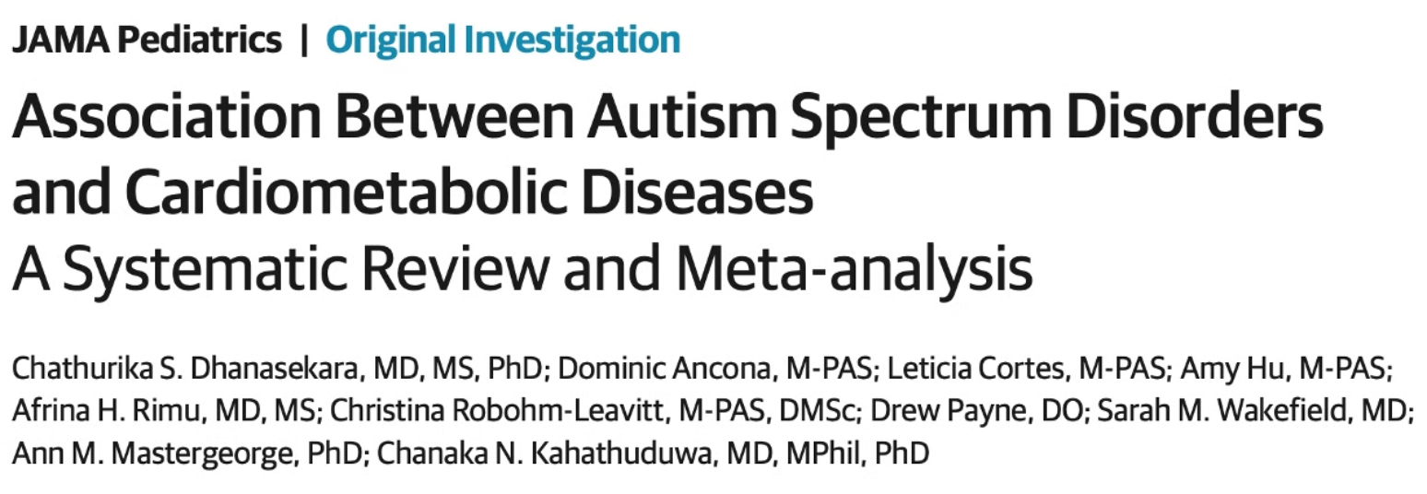
Comorbid evidence of cardiometabolic conditions in ASD
Diabetes (RR=1.6)
Dyslipidemia (RR=1.7)
Heart disease (RR=1.5)
ASD
Dhanasekara, Chathurika S., et al (2023)

Slide 7
Literature gap
Cross-sectional data
Limited adult data
Confounding factors
Most existing studies rely on cross-sectional data from children and young adults, with small sample sizes.
There is a lack of research on the prevalence and risk factors for cardiometabolic conditions in adults with ASD.
Many studies have not adjusted for potential confounders such as socioeconomic status (SES).
Longitudinal relationships?

Slide 8
Aims
1
Prospective associations
To investigate the prospective associations
between ASD and cardiometabolic conditions across the lifespan.
2
Age and sex differences
To examine these associations by age and sex.

Slide 9




Data Sources
Nationwide register-based data
Demographics
Statistics Netherlands
(Centraal Bureau voor de Statistiek, CBS)
Medical claims data
Diagnoses from the specialist medical care
Medication dispensation register

Slide 10
Design
Exposure
Main Outcomes
Diagnosis of ASD (DSM 4)
Incident cardiometabolic conditions
(including hypertension, diabetes, dyslipidemia, stroke, angina pectoris, myocardial infarction, and heart failure.)

Slide 11
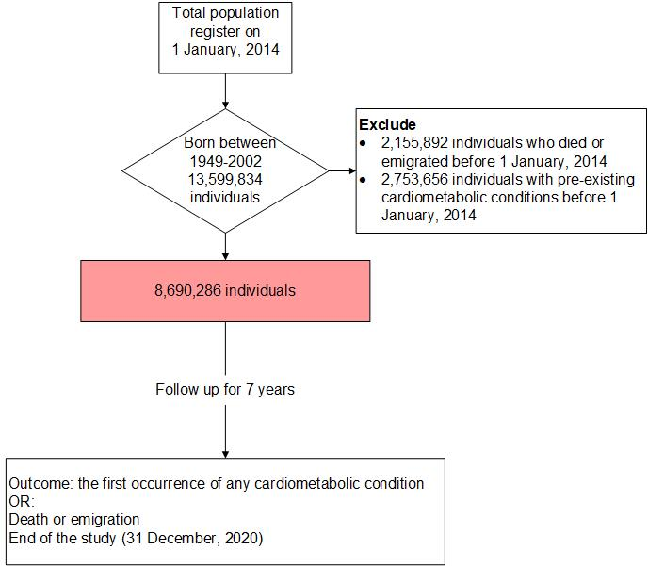
Figure 1. Flowchart of sample inclusion and exclusion
Design

Slide 12
Statistical Analysis
Cox proportional-hazards models
Cardiometabolic conditions ~ ASD
Sex- and age-stratified subgroup analyses

Slide 13
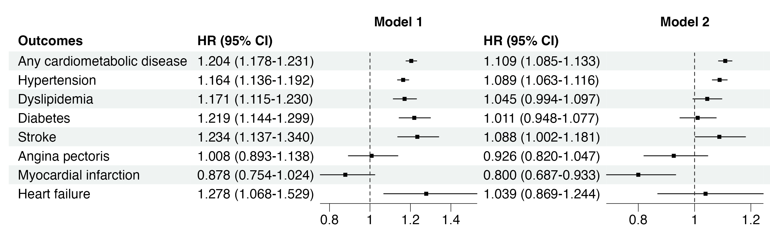
Table 1. Hazard ratio (HR) with 95% confidence interval (CI) of developing different types of cardiometabolic conditions among individuals with ASD, compared with those without ASD
Model 1: + birth year + sex
Model 2: + birth year + sex + SES

Slide 14
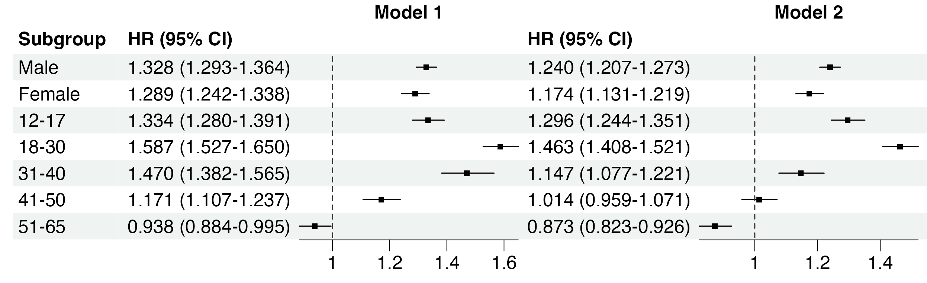
Table 2. Sex- and age-specific hazard ratio (HR) with 95% confidence interval (CI) of developing any cardiometabolic condition among individuals with ASD, compared with those without ASD
Model 1: + birth year + sex
Model 2: + birth year + sex + SES

Slide 15
Table 3. Age-specific hazard ratio (HR) with 95% confidence interval (CI) of developing cardiometabolic conditions among individuals with ASD, compared with those without ASD

Slide 16
Table 3. Age-specific hazard ratio (HR) with 95% confidence interval (CI) of developing any cardiometabolic condition among individuals with ASD, compared with those without ASD (continued)
Model 1: + birth year + sex
Model 2: + birth year + sex + SES

Slide 17
Conclusions
1
Increased risk of cardiometabolic conditions in ASD
such as hypertension, dyslipidemia, diabetes, stroke, and heart failure.
2
No association with angina pectoris or myocardial infarction
3
Similar estimates for men and women
4
Prominent associations in younger age groups
Associations were particularly prominent in the younger age groups,
indicating an earlier age at onset of cardiometabolic conditions in ASD.

Slide 18
Limitations
1
Only diagnoses from specialists
First, the DBC system only includes diagnoses from specialists rather than general practitioners, potentially leading to under-classification of cardiometabolic conditions, especially milder forms.
2
Historical under- or misdiagnosis of ASD
Due to the historical under- or misdiagnosis of ASD in older generations, the associations between ASD and cardiometabolic conditions may be underestimated.
3
Causality?

Slide 19









Slide 20

Thank you!

Slide 21
Table 1. Characteristics of individuals with and without ASD
 | Total N(%) | Subgroup N(%)
Characteristic | N = 8,690,286 | No ASD N = 8,578,491 | ASD N = 111,795
Sex (male) | 4,511,656 (51.92) | 4,429,222 (51.63) | 82,434 (73.74)
Age category (year)
12-17 | 1,168,587 (13.45) | 1,124,945 (13.11) | 43,642 (39.04)
18-30 | 2,351,148 (27.05) | 2,311,309 (26.94) | 39,839 (35.64)
31-40 | 1,553,801 (17.88) | 1,541,797 (17.97) | 12,004 (10.74)
41-50 | 1,786,116 (20.55) | 1,775,948 (20.70) | 10,168 (9.10)
51-65 | 1,830,634 (21.07) | 1,824,492 (21.27) | 6,142 (5.49)
Prevalence of cardiometabolic conditions
Any cardiometabolic condition | 1,113,030 (12.81) | 1,101,573 (12.84) | 11,457 (10.25)
Hypertension | 858,477 (9.88) | 849,347 (9.90) | 9,130 (8.17)
Dyslipidemia | 354,405 (4.08) | 352,235 (4.11) | 2,170 (1.94)
Diabetes | 136,178 (1.57) | 134,925 (1.57) | 1,253 (1.12)
Stroke | 96,225 (1.11) | 95,498 (1.11) | 727 (0.65)
Angina pectoris | 65,756 (0.76) | 65,430 (0.76) | 326 (0.29)
Myocardial infarction | 42,329 (0.49) | 42,119 (0.49) | 210 (0.19)
Heart failure | 21,279 (0.24) | 21,125 (0.25) | 154 (0.14)
 | Total N(%) | Subgroup N(%)
Characteristic | N = 8,690,286 | No ASD N = 8,578,491 | ASD N = 111,795
Sex (male) | 4,511,656 (51.92) | 4,429,222 (51.63) | 82,434 (73.74)
Age category
12-17 | 1,168,587 (13.45) | 1,124,945 (13.11) | 43,642 (39.04)
18-30 | 2,351,148 (27.05) | 2,311,309 (26.94) | 39,839 (35.64)
31-40 | 1,553,801 (17.88) | 1,541,797 (17.97) | 12,004 (10.74)
41-50 | 1,786,116 (20.55) | 1,775,948 (20.70) | 10,168 (9.10)
51-65 | 1,830,634 (21.07) | 1,824,492 (21.27) | 6,142 (5.49)
Prevalence of cardiometabolic diseases
Any cardiometabolic disease | 1,113,030 (12.81) | 1,101,573 (12.84) | 11,457 (10.25)
Hypertension | 858,477 (9.88) | 849,347 (9.90) | 9,130 (8.17)
Dyslipidemia | 354,405 (4.08) | 352,235 (4.11) | 2,170 (1.94)
Diabetes | 136,178 (1.57) | 134,925 (1.57) | 1,253 (1.12)
Stroke | 96,225 (1.11) | 95,498 (1.11) | 727 (0.65)
Angina pectoris | 65,756 (0.76) | 65,430 (0.76) | 326 (0.29)
Myocardial infarction | 42,329 (0.49) | 42,119 (0.49) | 210 (0.19)
Heart failure | 21,279 (0.24) | 21,125 (0.25) | 154 (0.14)

